Slide 1
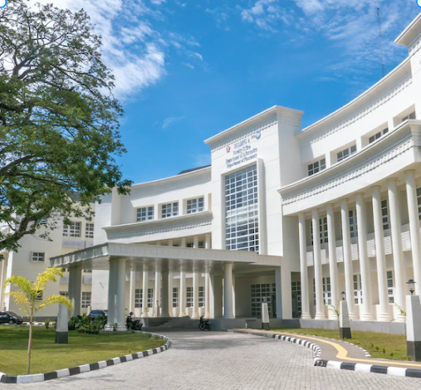
HOSTEL GATEPASS MANAGEMENT
Presented by,
Sindhiya V B
Swathi R
Sneka C
Priya L
Maniyarasan V
Guided by,
Rafridevi R
Janani P
Vijayalakshmi S
Anjana S
Varun Rishwandh S

Slide 2
PROBLEM STATEMENT
A comprehensive solution to make Hostel gate pass management operations to digitize , simplify, centralize
A problem in the manual , paper-based process that leads to inefficiencies ,lost documentation and difficulties in tracking and verifying passes.

Slide 3
SOLUTION
To address the hostel gate pass management problem, develop a user-friendly digital gate pass system with real-time tracking and automated approval workflows.
This solution will streamline the process , Improve transparency , reduce delays , benefiting both student and admin.

Slide 4
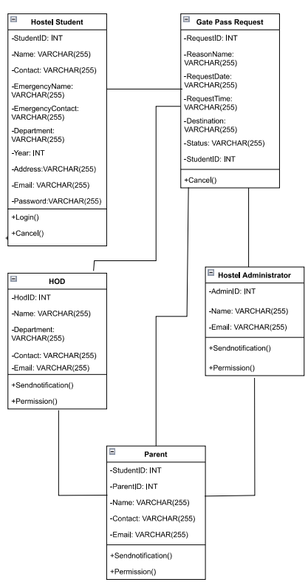
PHYSICAL WORK MODEL

Slide 5
^{WORK FLOW}
Admin accept the request from
Student and send pop-up message to parent
Hod accept the request and approved for the gate pass
Parent
HOD
Student
Warden
After parent accepting the request , the request sent to the Hod
After Login, Select the new request and send the request to
admin

Slide 6


MS SQL
^{TECHNOLOGY}
^{STACK}
^{SPRING BOOT}
^{REACT JS}
SQL Query
Java
SQLite

Slide 7
Figma link ▶ Sneka - Login - Gate Pass App (figma.com) Swagger link localhost DEMO

Slide 8
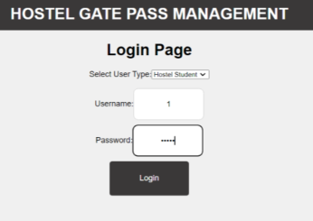
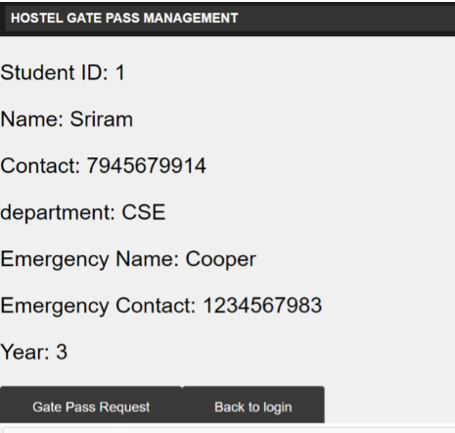
Hostel Student Login
^{FRONT END}

Slide 9
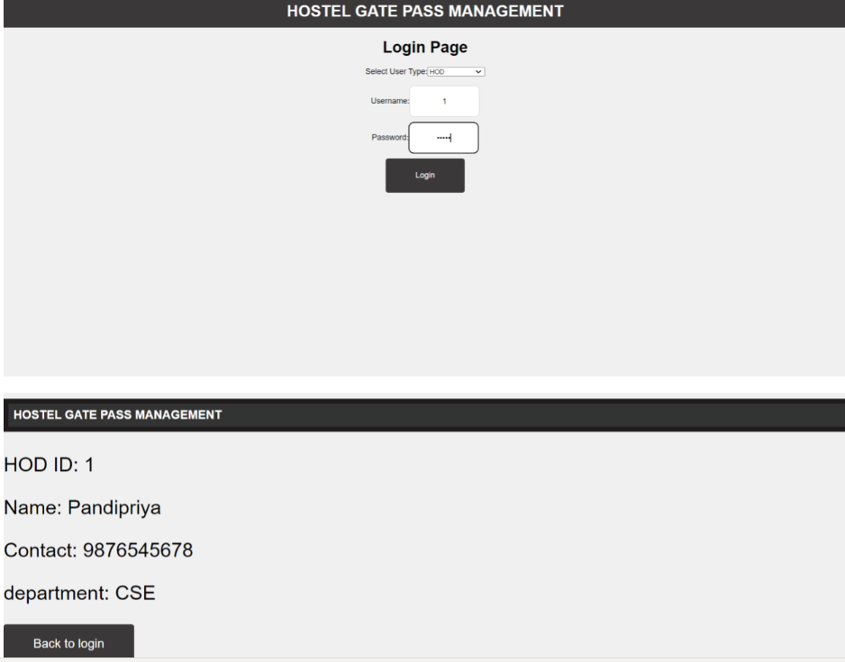
HOD Login
^{FRONT END}

Slide 10
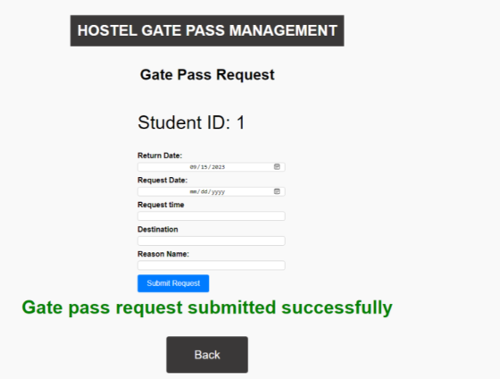
Gate Pass Request
^{FRONT END}

Slide 11
Advantages
Convenience : students can easily request and obtain gate passes through the application.
Reduced Administrative Burden : Hostel administrators can streamline the process of issuing and tracking gate passes , reducing paperwork and administrative works.
Cost Savings : Reduces paperwork and administrative overhead , potentially
Saving time and resources.
Data Accuracy : Maintains accurate records , reducing the potential for manual errors and disputes.

Slide 12
Future Scopes
Intimating parents through email and SMS (as not everyone would have email IDs), email for Warden & HODs
For now it works as a single college model , so we could scale this to include multiple colleges.

Slide 13
Thanks to Mr. Cooper and Leadership Team for giving us the opportunity to explore more, be more fearless, and adapt to change better! Thank you for your support.

Slide 14
^{THANK YOU!}

